Slide 1
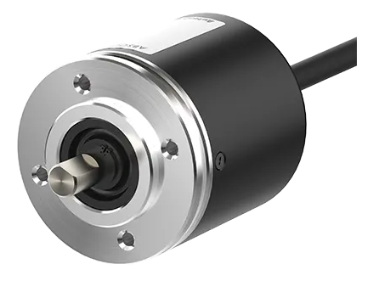
EP50S8 Steering Encoder
Description
The EP50S8-1024-2F-P-24 is a high-precision rotary encoder designed for steering angle measurement in automotive and industrial applications.
It provides accurate feedback on steering position and movement, ensuring precise control.
This incremental encoder excels in environments requiring robust performance and reliability.
Specifications
Operating Voltage - 12V to 24V
Resolution - 1024P/R
Frequency - 35kHz
Revolution - 3000 RPM
Applications
Steering Systems (Automotive)
Robotics and Automation
Industrial Machinery
Precision Motion Control
Official Website : https://www.autonics.com/in/model/EP50S8-1024-2F-P-24

